Slide 1
That “One” Team
SE300 Spring 2013
Brian Powell
Brittany Rompa
Craig Wilkerson
Muraad Khan
Yutong Zhu

Slide 2
High Level Design
addAirport – JDialog that allows the user to enter new airports to the system.
Airport – object of airports are created from this class for searching purposes.
DaGUI- main GUI that the user sees. Calls all the JDialogs at the appropriate times
DeleteRoute – allows the user to delete any route they so desire. Extends JDialog.
Director – this class is responsible for maintaining any routes or airports in the background. Also updates any tables or results

Slide 3
High Level Design (contd.)
editRoute – provides the user with the ability to edit any route currently in the system. Extends JDialog
FileInput – responsible for reading in the input file. Checks to make sure the file exists. Checks for bad syntax and the like using regular expressions
Graph – this class is responsible for building and searching the graph to return paths between two locations
Innerclasses: path and routePath
Main – contains the main method that calls DaGUI
Node – this is the premise for the Graph
Innerclass: edge

Slide 4
High Level Design (contd.)
Open_Close_Box – this allows the user to close airports and reopen them. Extends JDialog.
Route – this class is also used for graphing purposes. Contains all information regarding route
routeFrame – allows user to create new routes. Extends JDialog.

Slide 5
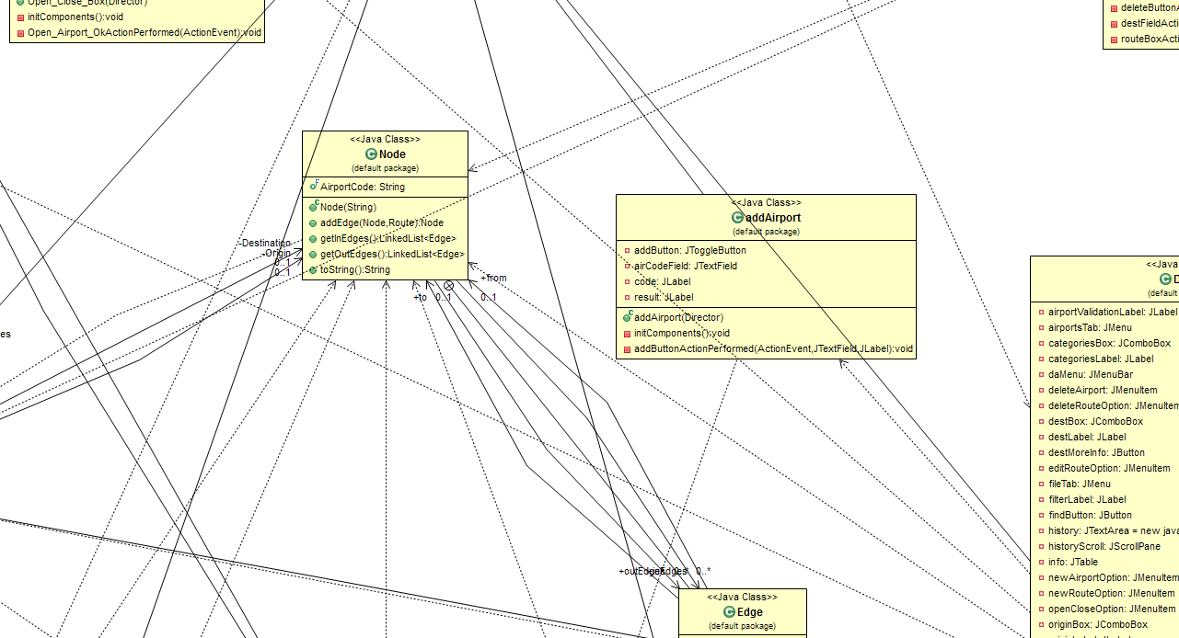

Slide 6
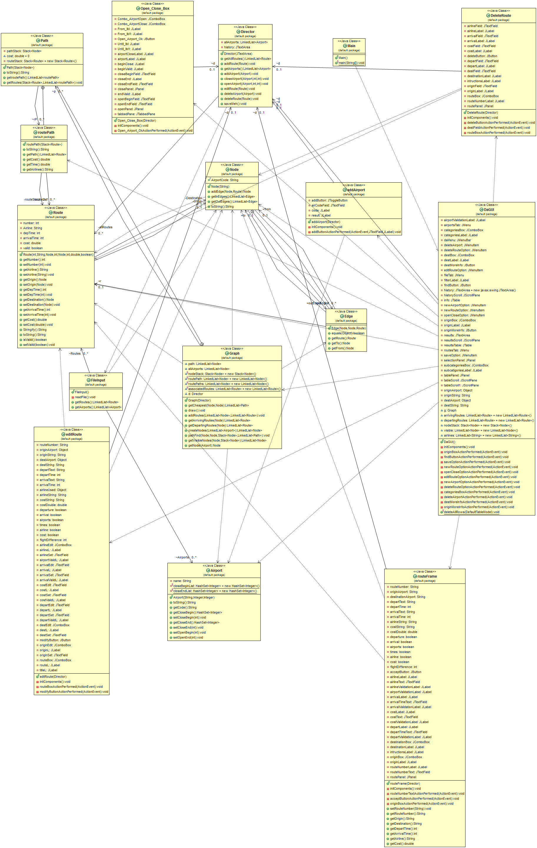

Slide 7
Detailed Design
What’s a graph and how does it work?

Slide 8
Functionality
What does it do versus what its supposed to do?
How do we know?

Slide 9
Metrics
4337 source lines of code
210 team hours total
100 Cycle 2
110 Cycle 1
100 defects
Roughly 50% came during coding

Slide 10
Managing Team
What approaches were used?
Change management
How did we all mesh together?

Slide 11
Managing Requirements
How did we know we were building the right product?

Slide 12
Lessons Learned
Keep requirements in mind better
Have a better idea of what needs to happen in terms of code
Case and point: Our finding paths has a cyclomatic complexity of 50
One of our methods in the GUI has a correlation of 1780%
Tools that are available to use

